Slide 1

HELLO!
I am Saurabh Bharadwaj
~ Machine Learning Intern ~

Slide 2
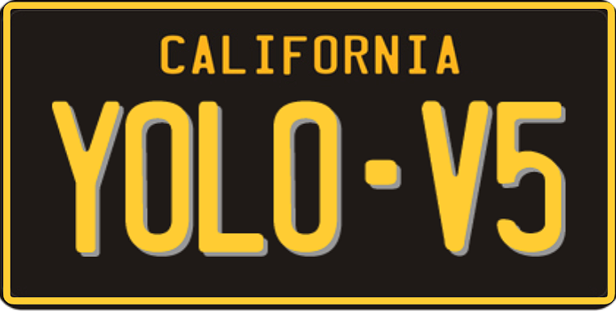
CAPSTONE PROJECT
License Plate Detection and Recognition

Slide 3

Expectations and Targets
Use yolo/ssd/retinanet to train a license plate detector
Use a Segmentation technique to extract the text on the license plate
Use a recognition method/OCR to recognize the text on the license plate
Test out your solution on images you click of license plates.
Try to minimize the latency of the solution as much as possible (ONNX runtimes, tflite, tensorrt,tf-trt etc)

Slide 4
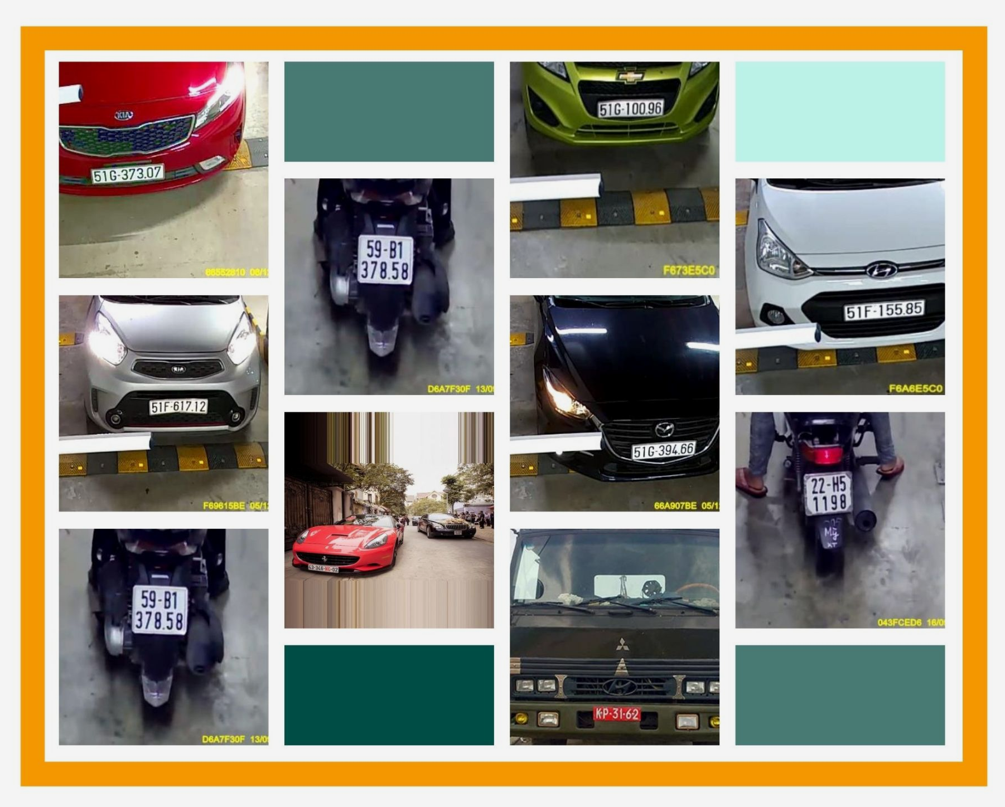
Dataset Description
8,298
1,500
1
Vietnamese License Plate Dataset
Total Images
Test Images
Class (Licence Plate)

Slide 5
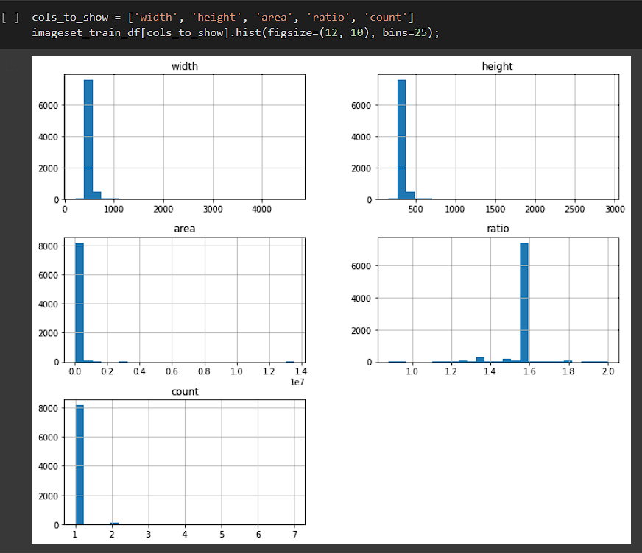
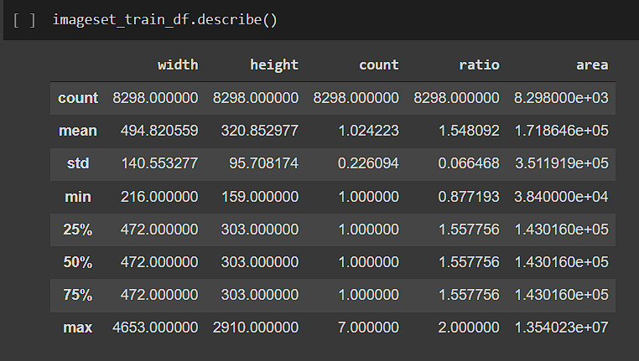
Data Analysis
Train Dataset Description
YELLOW
Is the color of gold, butter and ripe lemons. In the spectrum of visible light, yellow is found between green and orange.

Slide 6
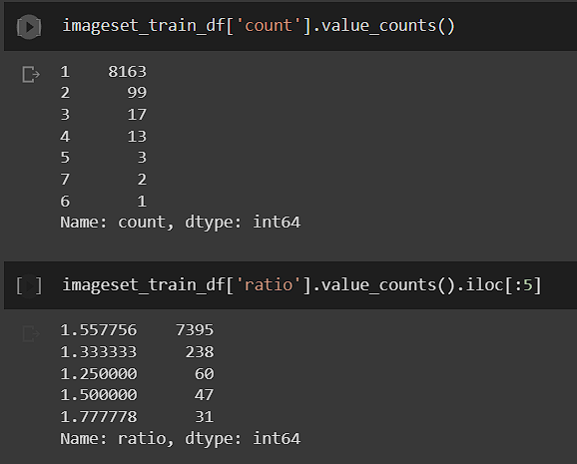
Data Analysis
2. Frequency of Plate classes in Images
3. Distribution of Ratio value in Images (Top 5)

Slide 7
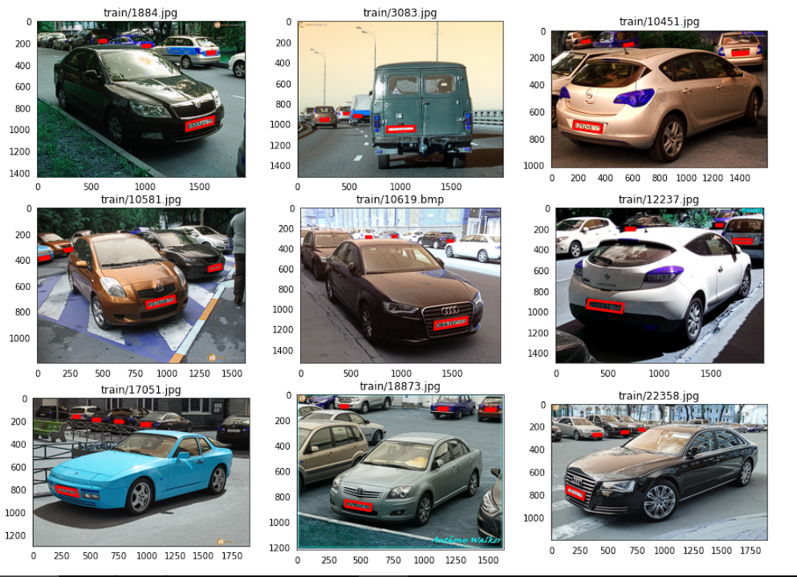
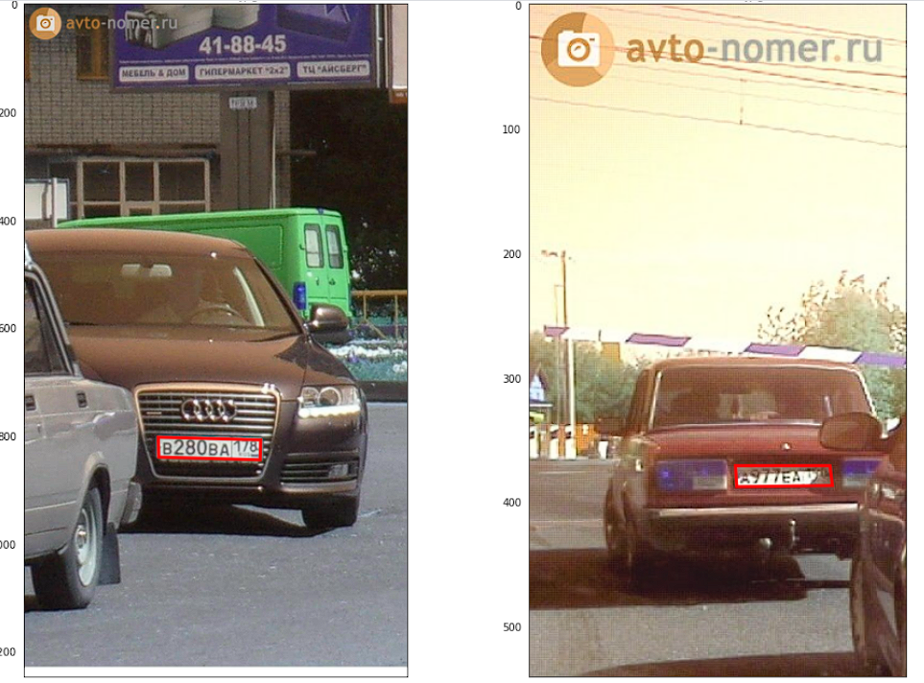
Sample Images

Slide 8
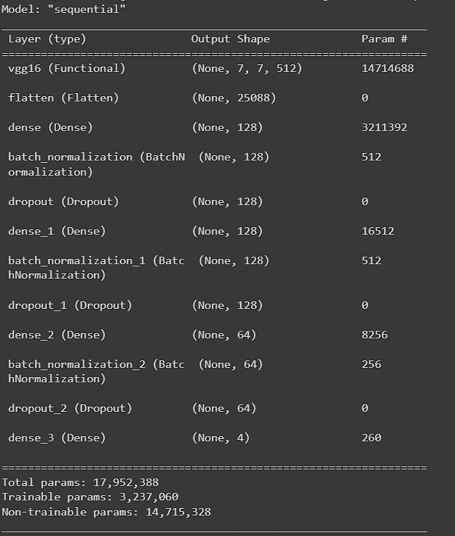
Trying out with Base Model
Input:
1/3rd Dataset ~ 2,800 Images
Width, Height, Channels = (224, 224, 3)
Layers:
Base Layer: VGG16
Trainable Params: 3M
Output:
Sigmoid Outputs: 4
(xmin, ymin, xmax, ymax)

Slide 9
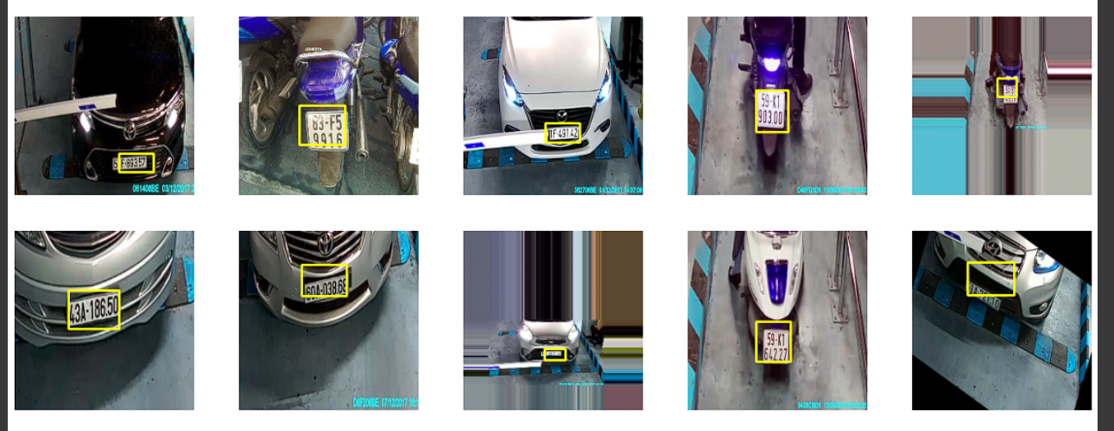
Images Output
Image Outputs with respective Bounding boxes around the Number Plate

Slide 10
The Problem
My model, will not scale to ‘N’ number of plates in the Image/Video.
As we dont know exactly how many number plates will be there on the image.
Is this it?
No! This model is very slow and huge in size. We need something efficient.

Slide 11
YOLO v5
Object Detection model
Compound Scaled
Trained on COCO Dataset
Simple implementation for TTA, Hyperparameter evolution, and exporting to ONNX, TensorRT, TFLite

Slide 12
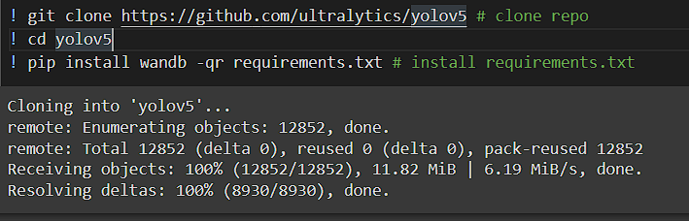
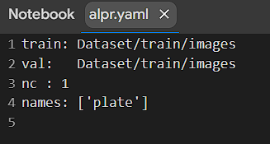
Yolov5 Setup
Clone YOLOv5 repo from Github
2. Creation of custom alpr.yaml file

Slide 13
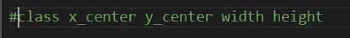
Yolov5 Setup
3. Get the annotations to match with YOLO config.
4. After proper configuration, train the model
Output results: Custom yolo output
5. Detection and testing the model

Slide 14
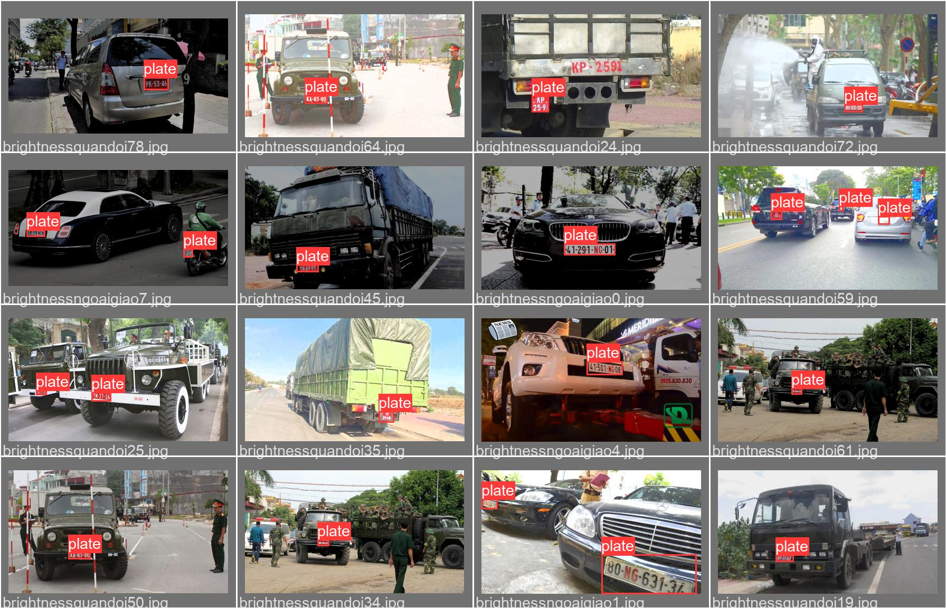
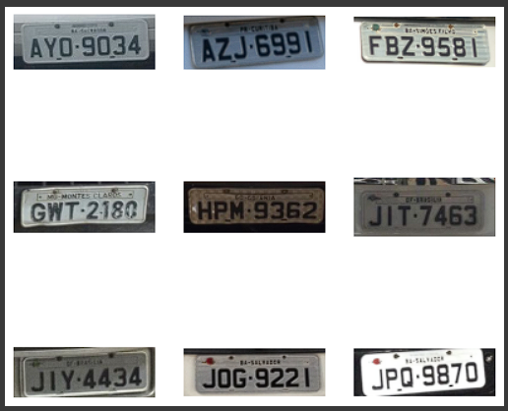
Results from the detection

Slide 15
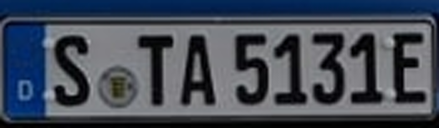
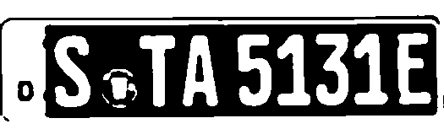
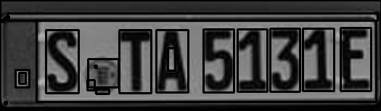
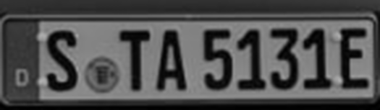
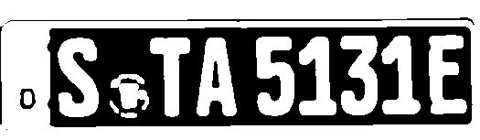

Number Plate Segmentation
Blue is the colour of the clear sky and the deep sea
Red is the colour of danger and courage
Black is the color of ebony and of outer space
1
3
5
2
4
6
Yellow is the color of gold, butter and ripe lemons
White is the color of milk and fresh snow
Blue is the colour of the clear sky and the deep sea

Slide 16
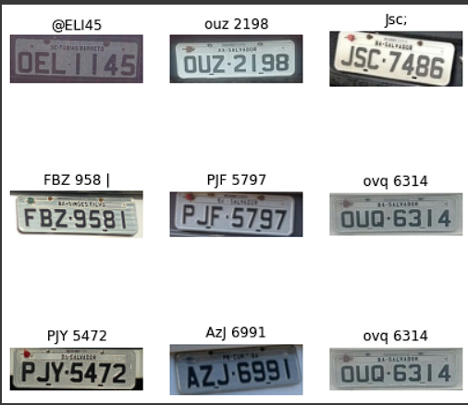
Output

Slide 17
Optimizing and Quantizing model
SIZE
13.7 Mb
13.5 Mb
27.2 Mb
Current Best Model
best.pt
Quantised TFLite FP-16
best-fp16.tflite
ONNX
best.onnx
Inference Time
263.8 ms
519.6 ms
295.8 ms

Slide 18
Quantized INT8 model
1
7 Mb
best-int8.tflite
Very High ~ 20 s

Slide 19
Applications
Detect and Recognise Number Plates.
Swapping the Number Plates
Blur/Distort the Number Plate

Slide 20
Any Questions?
Thank You!

